Slide 1
Homogeneous atmospheric temperatures derived from IASI : retrieval, extreme events and trends
Marie Bouillon¹, Sarah Safieddine¹, Lieven Clarisse², Simon Whitburn², Filipe Aires³, Victor Pellet³, Olivier Lezeaux⁴, Noëlle A. Scott⁵ and Cathy Clerbaux^{1,2}
¹ LATMOS/IPSL, Sorbonne Université, UVSQ, CNRS, Paris, France
² Université Libre de Bruxelles (ULB), Spectroscopy, Quantum Chemistry and Atmospheric Remote Sensing (SQUARES), Brussels, Belgium
³ LERMA, CNRS, Observatoire de Paris, Paris, France
⁴ SPASCIA, Ramonville-Saint-Agne, France
⁵ Laboratoire de Météorologie Dynamique, CNRS/IPSL, Ecole Polytechnique, Université Paris-Saclay, Palaiseau, France

Slide 2
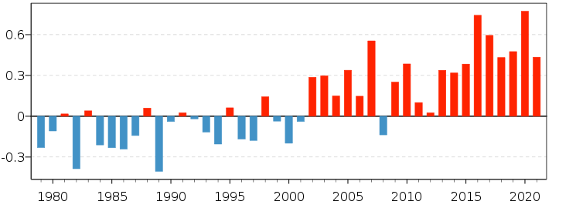
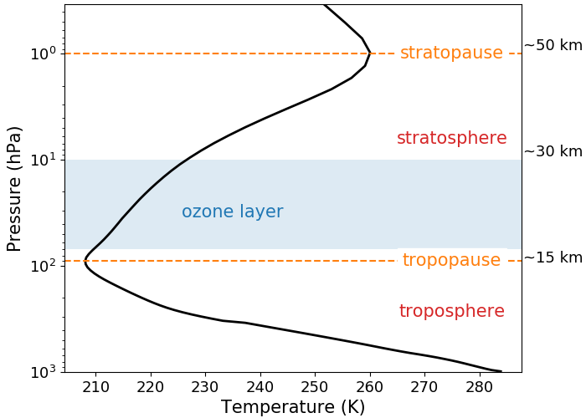
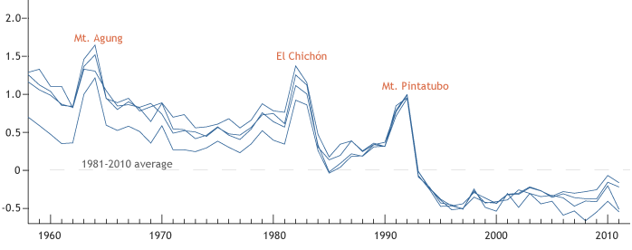
Evolution of atmospheric temperatures
Introduction Retrieval and validation Applications Conclusions and perspectives
Warming of the troposphere
Cooling of the stratosphere
Troposphere : decrease of temperature with altitude
Stratosphere : increase of temperature with altitude
Air surface temperature in January (C3S/ECMWF)
0.6
0.3
0
-0.3
1980 1985 1990 1995 2000 2005 2010 2015 2020
Anomalie with respect to 1981-2010 (°C)
Stratospheric temperatures (Blunden and Arndt, 2012)
2.0
1.5
1.0
0.5
0
-0.5
1960 1970 1980 1990 2000 2010

Slide 3
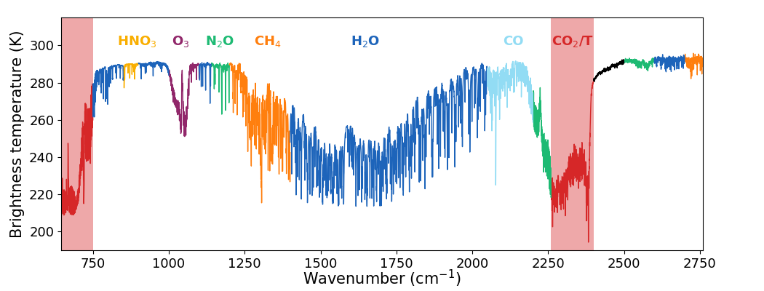
Atmospheric temperatures in the IASI spectrum
Introduction Retrieval and validation Applications Conclusions and perspectives
CO₂ : long-lived gas and stable concentration
Retrieval of atmospheric temperatures from the CO₂ absorption bands
Wavenumber > 2300 cm⁻¹ : high instrumental noise and solar contamination
Atmospheric temperatures computed by EUMETSAT

Slide 4
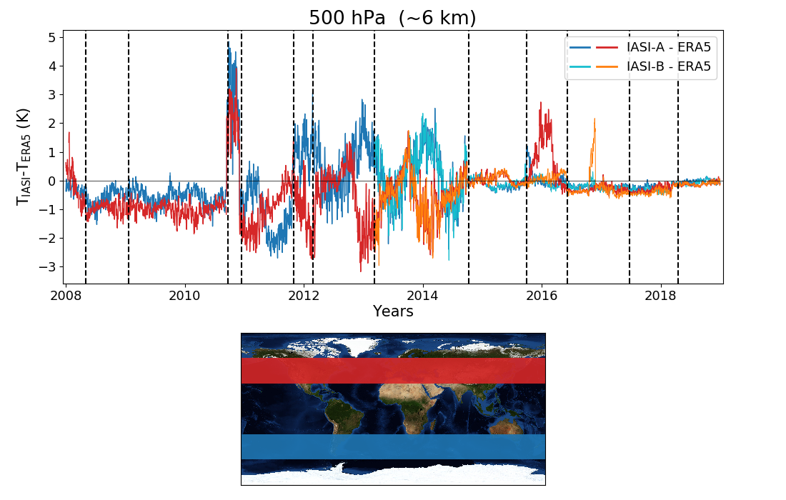
Analysis of the EUMETSAT operational product
Introduction Retrieval and validation Applications Conclusions and perspectives
Several updates
Last version : PieceWise Linear Regression (PWLR) and Optimal Estimation Method (OEM)
Comparison with ERA5
ERA5 temperatures interpolated to the time/latitude/longitude of IASI observations
Two major updates :
2010 : cloud processing
2014 : new IASI L2 processor
The differences decrease over time
Improvement of the product
Bouillon et al., 2020 (Remote Sensing)

Slide 5
Retrieval - Selection of IASI channels
Introduction Retrieval and validation Applications Conclusions and perspectives
Selection of IASI channels sensitive to the temperature profile
Channel selection based on the entropy reduction method (ER)
B : a priori covariance matrix
R : instrumental noise and radiative transfer error covariance matrix
H : jacobian matrix H’ = R^{-1/2}H : jacobians normalised by the noise
h’ : normalised jacobian of one channel
Retrieval covariance matrix:
$$A=(B^{−1}+H^{T}R^{−1}H)^{−1}$$
Update of A :
Selection of the channel that reduces the most the entropy
$$A_{i}=A_{i−1}−\frac{(A_{i−1}h^{′})(A_{i−1}h^{′})^{T}}{1+(A_{i−1}h^{′})^{T}h^{′}}$$
$$δER=\frac{1}{2}\log_{2}(1+{h^{′}}^{T}A_{i−1}h^{′})$$

Slide 6
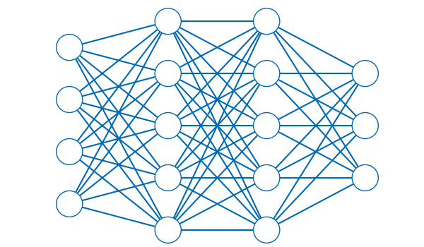
Retrieval - Selection of IASI channels
Introduction Retrieval and validation Applications Conclusions and perspectives
231 channels (CO₂ and N₂O absorption bands)
Input for a two hidden layer artificial neural network

Slide 7
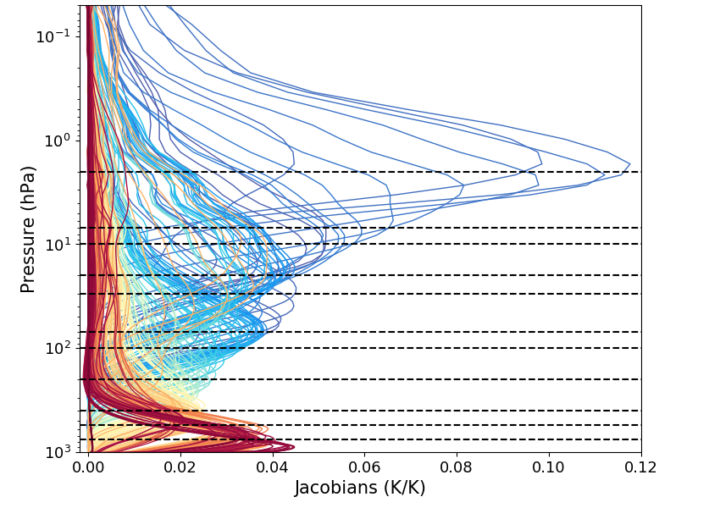
Retrieval - Artificial neural network
Introduction Retrieval and validation Applications Conclusions and perspectives
Trained with 450 000 observations
Input : radiances, scan angle, global CO₂ value
Output : ERA5 temperatures at 11 levels
Trained ANN applied to all IASI observations since 2007 (clear and cloudy scenes)
Metop-A for 2007-2017
Metop-B for 2018-present

Slide 8
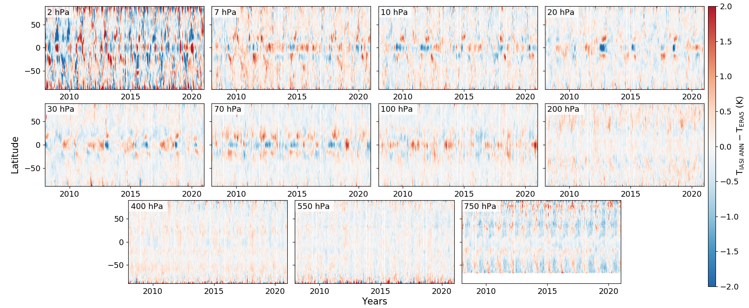
Validation - Comparison with ERA5
Introduction Retrieval and validation Applications Conclusions and perspectives
ERA5 interpolated to the time/latitude/longitude of IASI observations, daily zonal mean

Slide 9
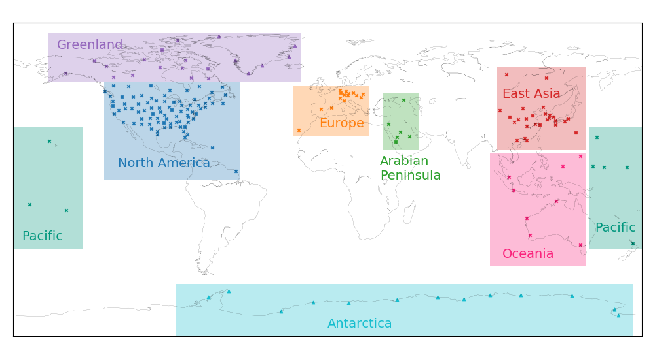
Validation - Comparison with ARSA
Introduction Retrieval and validation Applications Conclusions and perspectives
Analysed RadioSoundings Archive (N. A. Scott, LMD)
Database of radiosounding observations
Up to 30 hPa
159 stations with 300+ observations per year
14 stations in Antarctica
6 stations in Greenland
IASI-ANN temperatures interpolated to the coordinates of ARSA observations
8 regions : daily mean temperature in each region

Slide 10
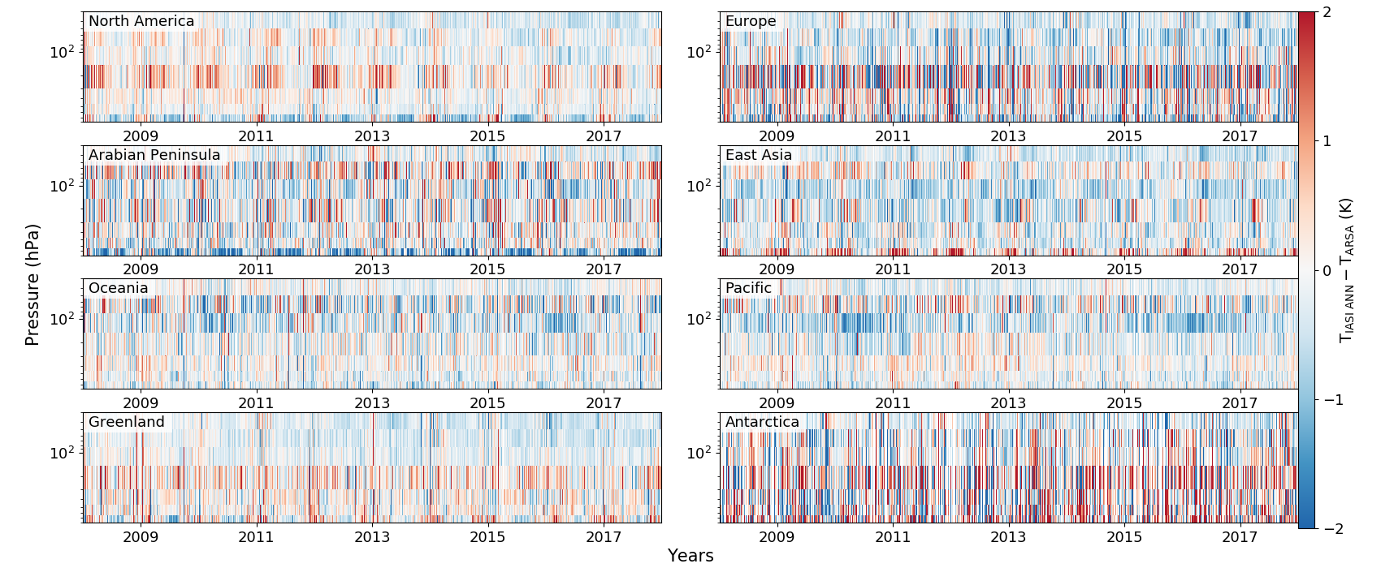
Validation - Comparison with ARSA
Introduction Retrieval and validation Applications Conclusions and perspectives

Slide 11
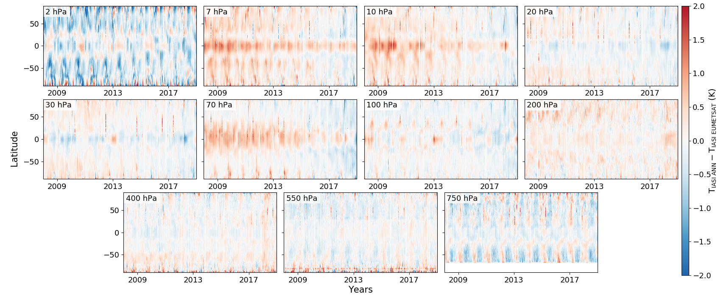
Validation - Comparison with EUMETSAT reprocessed data record
Introduction Retrieval and validation Applications Conclusions and perspectives
Reprocessed with PWLR, no OEM

Slide 12
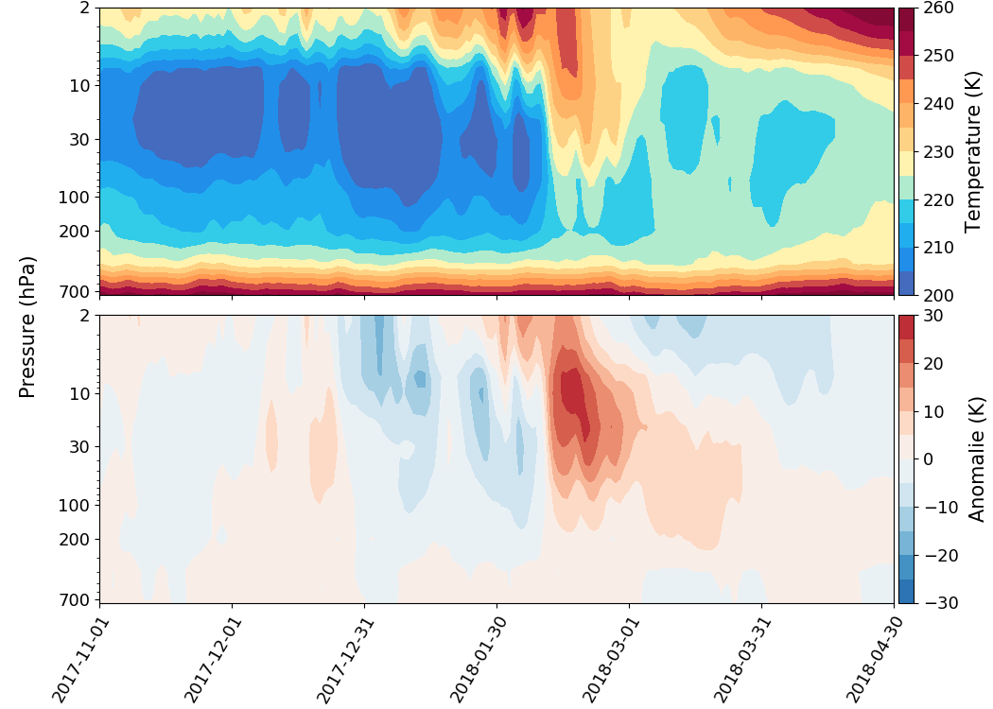
Sudden stratospheric Warming of February 2018
Introduction Retrieval and validation Applications Conclusions and perspectives
Extreme event caused by the displacement or splitting of the polar vortex
Stratosphere : + 40 K in 2 days
Troposphere : + 20 K
Temperature anomaly of + 30 K in February
+ 10 K in March
+ 5 K in April
Downward propagation

Slide 13
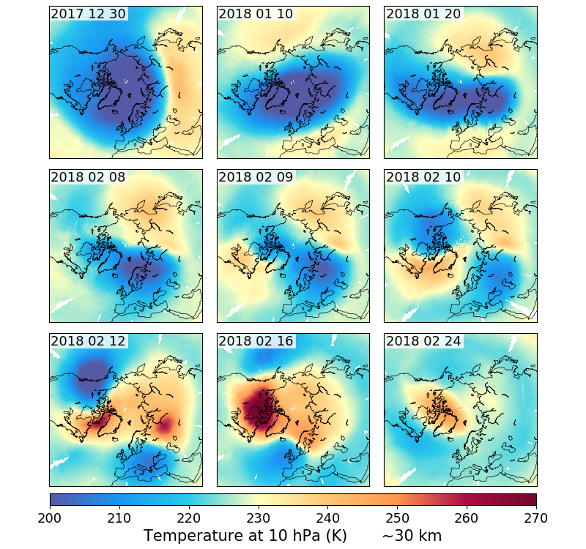
Sudden stratospheric Warming of February 2018
Introduction Retrieval and validation Applications Conclusions and perspectives
December : polar vortex in place
January : two air masses around the pole
February 10th : beginning of the perturbation
February 12th : the vortex splits
End of February : the perturbation decreases

Slide 14
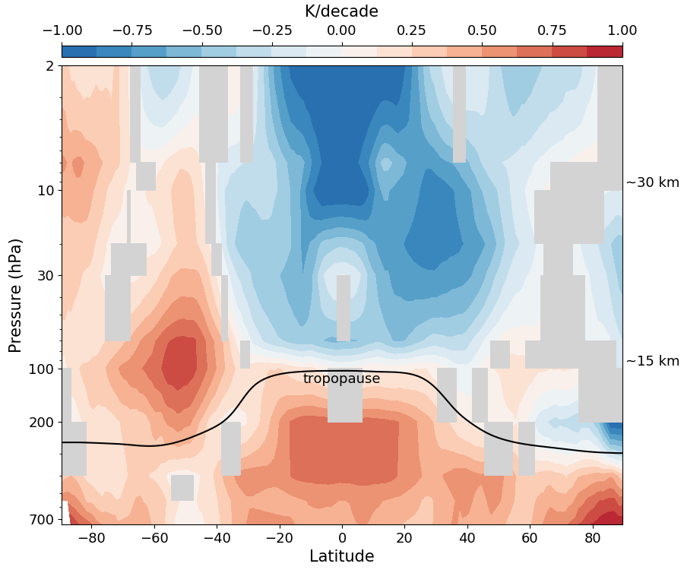
Trends over 2008-2020
Introduction Retrieval and validation Applications Conclusions and perspectives
Daily zonal mean temperatures
Theil-Sen estimator
Warming of the troposphere
Equatorial upper troposphere : 0.6 K/decade
Arctic : 1 K/ decade
Stratosphere :
No significant trends in the Arctic
Cooling between 40°S and 40°S
Warming in Antarctica (ozone hole recovery and SSW in 2019)
Bouillon et al., 2021 (AMTD)

Slide 15
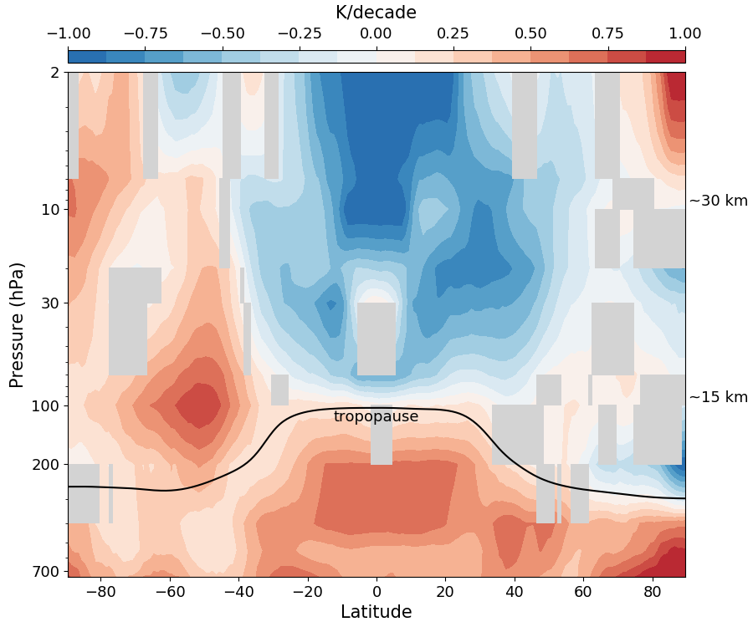
Trends over 2008-2020
Introduction Retrieval and validation Applications Conclusions and perspectives
ERA5 temperatures interpolated to the time/latitude/longitude of IASI observations
IASI ANN
ERA5

Slide 16
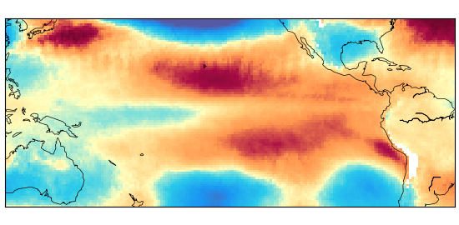
Conclusions
Introduction Retrieval and validation Applications Conclusions and perspectives
Computation of a new homogeneous temperature record from IASI radiances :
Selection of IASI channels
Artificial Neural Network
Validation with ERA5, ARSA and EUMETSAT CDR
Applications :
Sudden Stratospheric Warmings
Trends
Perspectives
Study of extreme events (SSW, heat and cold waves), trends ?
Links with ENSO
Link with OLR
IASI-NG
Whitburn et al., 2021

